Slide 1







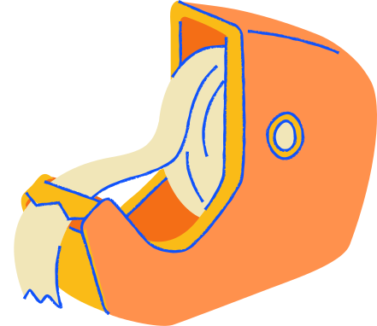
StressLess
Demo 3
Khanh Do, Nifemi Ogunmesa, Cheyanne Vinson, Madel Sibal, Alyssa Trapp, Tim Yu
Notes:
StressLess is a semester-long project for CSC-324, created by Khanh Do, Nifemi Ogunmesa, Cheyanne Vinson, Madel Sibal, Alyssa Trapp, and Tim Yu.

Slide 2
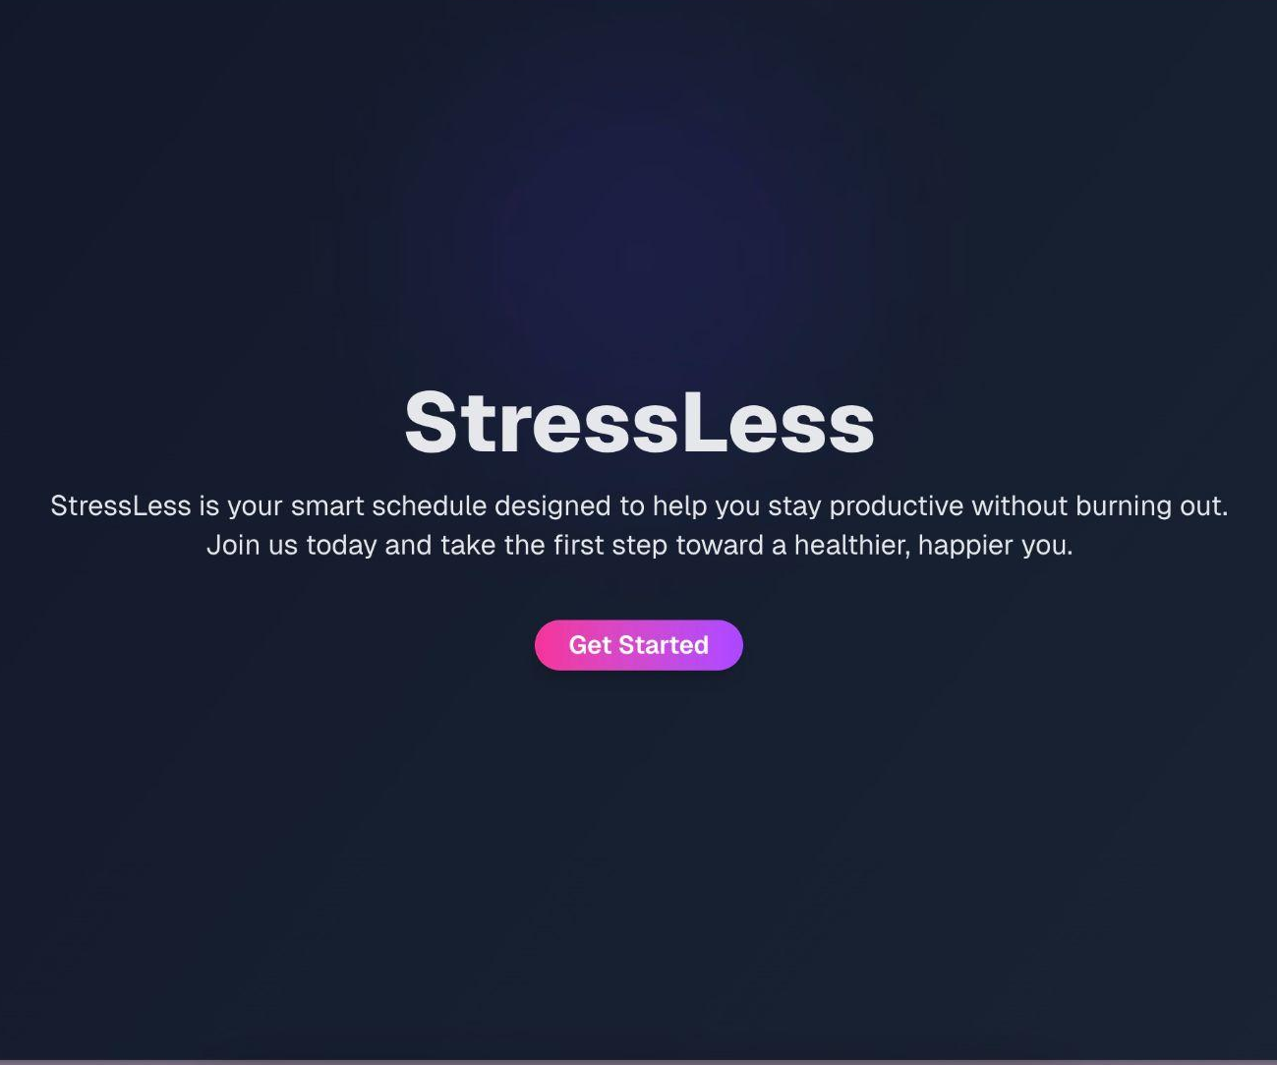
Our Product
A customized calendar tailored to your productivity preferences, break times, and scheduled events
Creates a calendar for an individual based on their survey answers and event plans
Notes:
Description of StressLess:
StressLess is a smart schedule tailored to an individual’s productivity preferences. The user can input their schedule and answer a preference survey, and StressLess will customize the best possible schedule for them based on user’s personal preferences to help them stress less
Alyssa

Slide 3








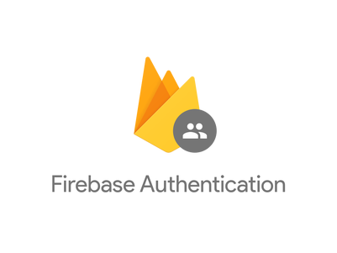



StressLess Software Architecture
User Interface (Frontend)
Business Logic (Backend)
Database
Public route
Protected route
API calls
Collects User Preferences endpoint
USER
Sign Up
Profile View
Write
(Create
Update
Delete)
Add/Update/Delete User Events endpoint
Sign In
Calendar View
Responses
Add/Update/Delete User Deadlines endpoint
Users
Validate token
Preferences
BROWSER
Generate Schedule endpoint
Questions
Read
Events
Issues uid token
Deadlines
Authentication & Authorization
(by third party)
Notes:
Implemented:
Frontend:
Authentication service
Sign up
Sign in
Sign out
Backend:
CRUD operations for auth
CRUD operations for events (note: updating not implemented in final version)
CRUD operations for deadlines (note: updating not implemented in final version)
CRUD operations for preferences
Database:
Writing and reading database (via Prisma)
Database schema implemented
Alyssa

Slide 4
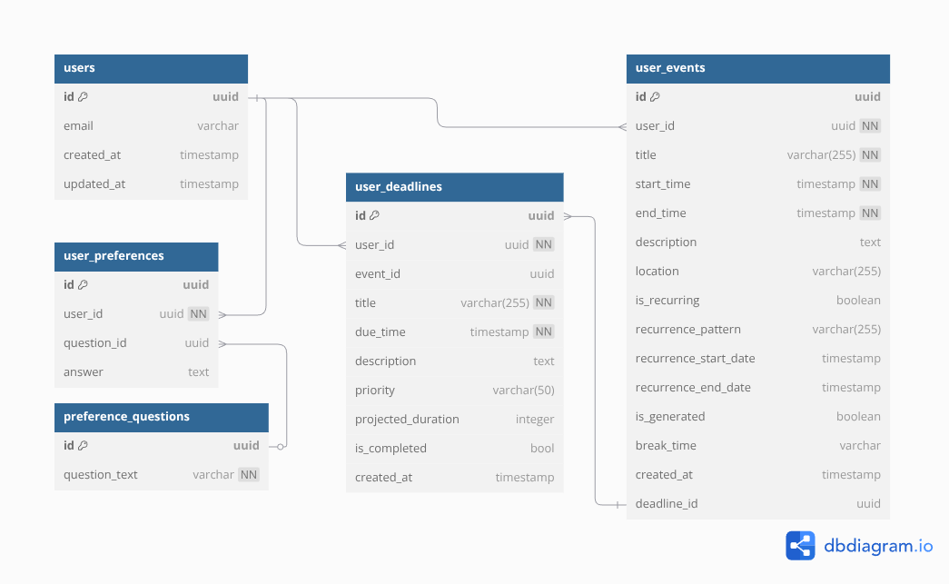
Notes:
All the tables are created already in accordance to the schema.
We use Prisma to create tables from the schema.
The database uses PostgreSQL hosted by Neon.
Alyssa

Slide 5




Demo Time!
Notes:
We will first show the new updates in our frontend, which is integrated with real API call to our backend. We also wrote unit tests for our backend API endpoints. We will also showed our Continuous Deployment pipeline.

Slide 6
New Features
Notes:
We will explain and demonstrate the new features we implemented.

Slide 7
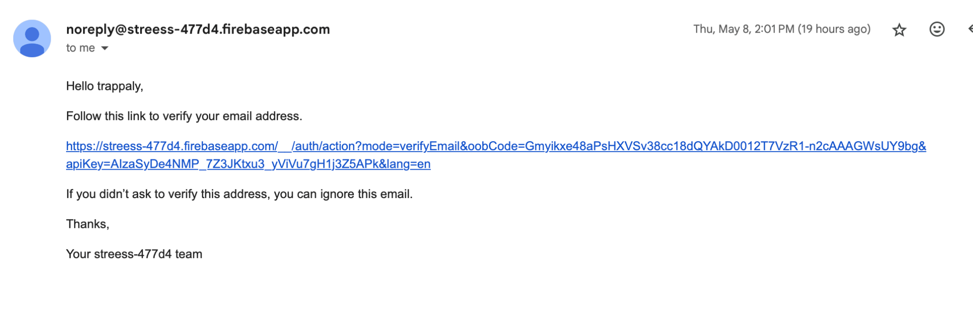
Added Email Verification
& Password Preview
Notes:
Khanh
Implemented email verification that that it needs the user email to verify their email which is sent to a user’s real gmail before the user can create and access their account

Slide 8
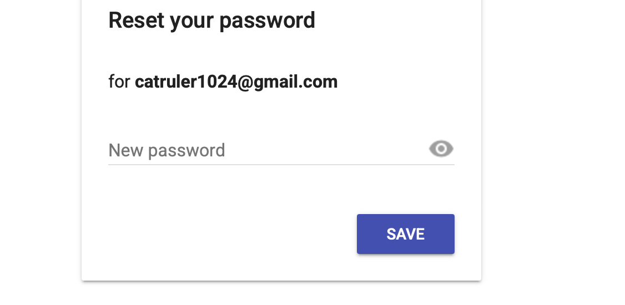
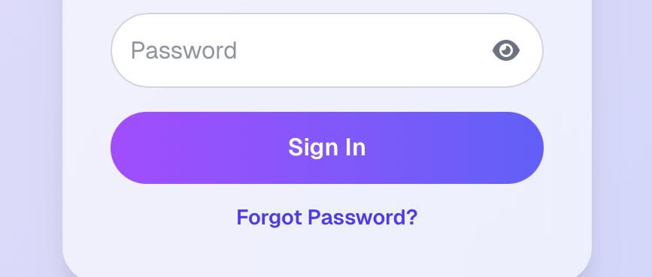
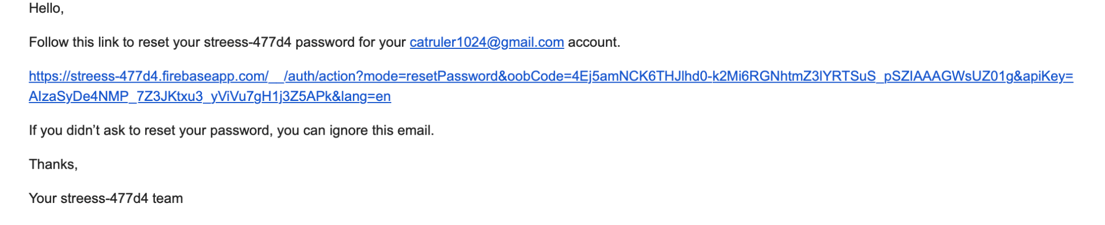
Forgetting Password
email@gmail.com
Notes:
Khanh
Implemented that if the user forgets their password, then they can send a forgot password to their email associated with their account to reset their password

Slide 9
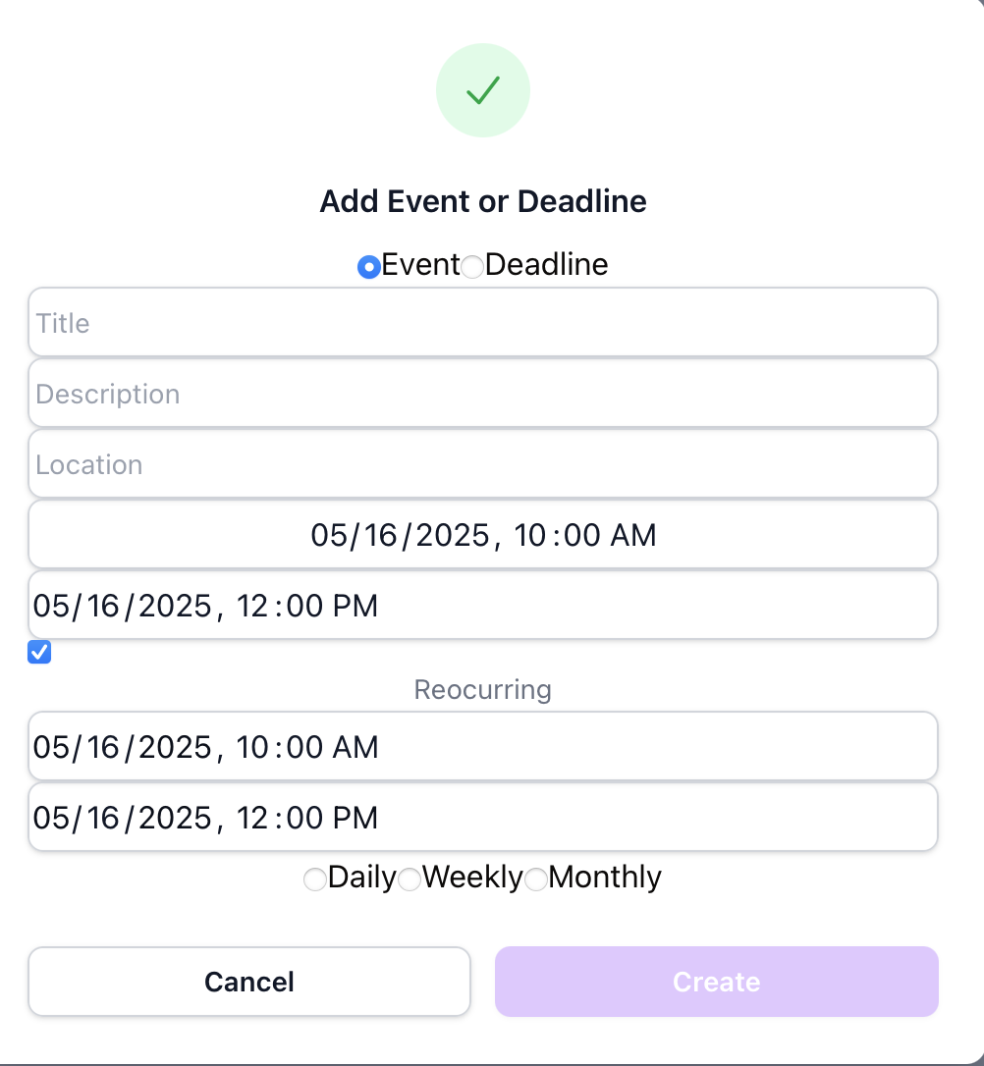
Added Inputs for Events
Can now customize events
Title
Description
Location
Manually enter start date and time and end time and time
Choose whether the event is reoccuring for daily, weekly, and monthly.
Notes:
Nifemi
You can now customize events in ways such as:
Enter title of event (just click on bar and start typing)
Customize description (just click on bar and start typing)
So the user knows where to type info we use placeholders such as “Description” to guide user on where to type so info can be properly stored in backend
Customize location (just click on bar and start typing)
Can manually enter start date and time and end time and time by clicking on calender icon
Can choose whether the event is reoccuring for daily, weekly, and monthly (sadly at the moment is just an option so when you pick it it gets saved in the backend for the user but is not shown on the current calendar as recurring event)
To ensure that only one option can be chosen we used “radio buttons” so that only one would be chosen then we save that choice to the backend
If event is selected to be recurring only then can you enter the start of the recurring event and the date at which that event will no longer be recurring
Can click on date create event and click on any event to cancel that event
Nifemi

Slide 10
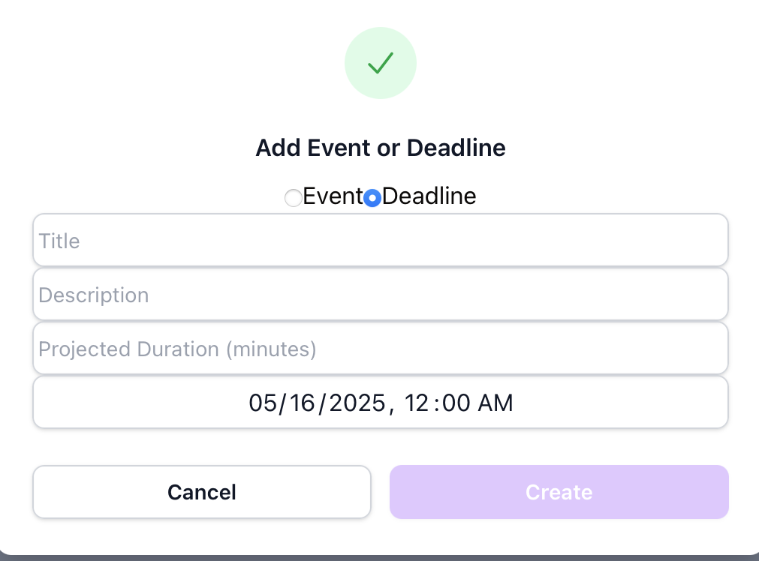
Added Deadline Option
In addition to EVENT, we now have DEADLINE
For deadlines we can customize
Title of the deadline
Description
Approximated duration to complete the deadline
Due date & time
Notes:
Nifemi
Now have an option to add either an event or a deadline rather than only events
The user can enter their assignments and the expected duration the assignment will take

Slide 11
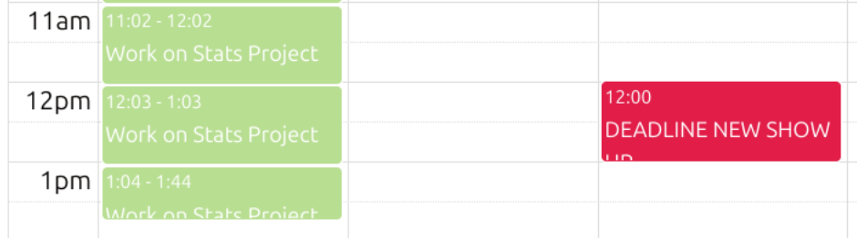
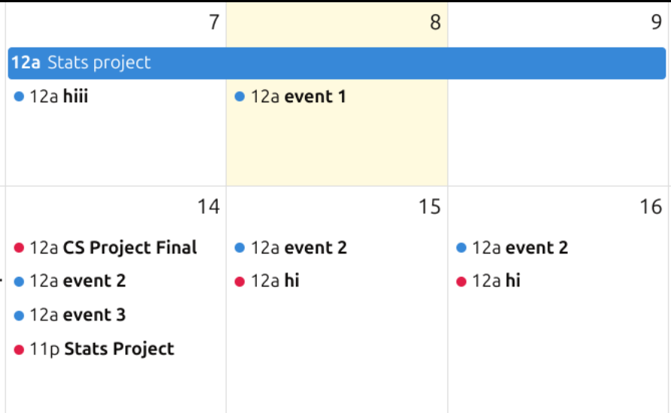
Colored Events/Deadlines
Notes:
Cheyanne
As you can see there “events” are different colors! This is because the auto generated events using the StressLess scheduler(we will talk about this more later) are in green, deadlines are RED to draw your attention and finally regular events are in blue

Slide 12
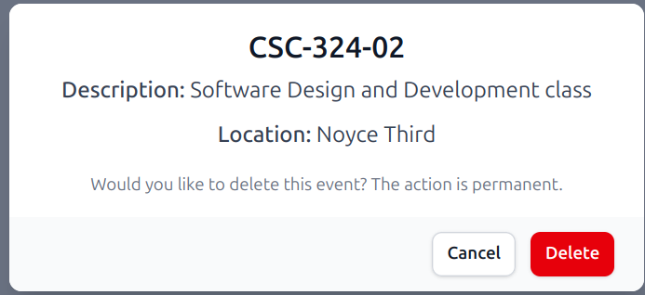
Delete Event/Deadline
Users can select the deadline/event and it will give them the option to delete them.
Event/deadline is removed from database and calendar view.
Notes:
Madel
Users can delete both events and deadlines

Slide 13
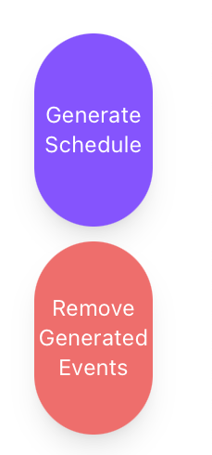
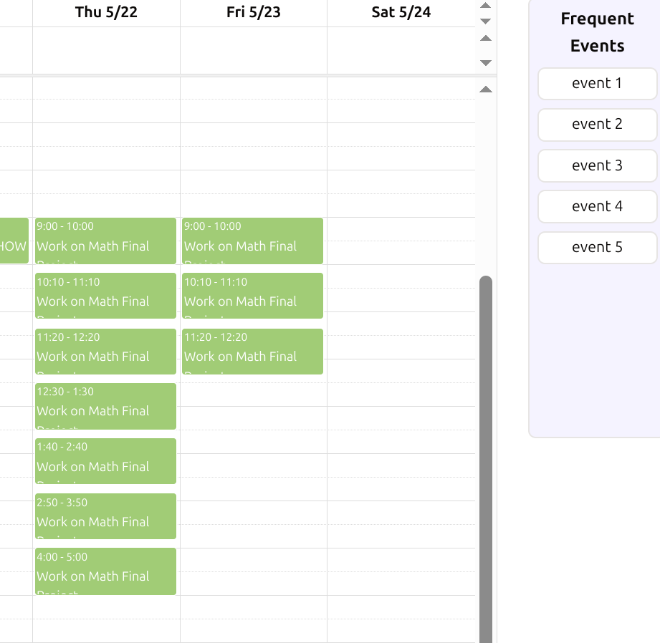
Generate/Remove generated Schedule
Generates calendar events for working on deadlines
Schedule is tailored to user preferences like sleep time, work day, productive hours, break time
Options to delete this generated schedule if wanted
Notes:
Khanh
The customizable scheduler algorithm now works
The user can click on generate schedule and the scheduler will customize built in study times and breaks for specific assignments
If they don’t like the generated schedule, they can also remove all of the generated events

Slide 14
Scheduler Logic
Inputs:
User’s events, deadlines, and preferences
For each deadline:
Calculate unscheduled minutes of deadline based on estimated duration and already scheduled events
Loop A: While unscheduled minutes > 0:
Search for next free time block within user’s working hours
If next free time block is after deadline:
Stop searching and break from Loop A
Make an event whose length is at most the user’s work duration
Automatically put in break time
Subtract duration of this event from unscheduled minute
Next time block must be an interval after the end of scheduled event
Outputs:
Array of newly scheduled events
Array of deadlines not fully scheduled
Notes:
Tim
Calculates deadlines on unscheduled minutes based on duration of already existing events
When the unscheduled minutes is greater than 0, then the algorithm will search for the next free time block within the user’s working hours
Scheduler creates schedule with built in break time

Slide 15
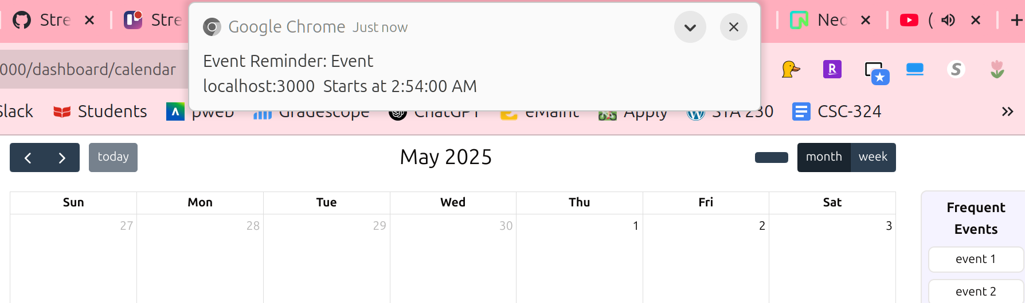
Added Notifications
Browser notifications are sent before the start of events.
Notes:
Alyssa
When creating an event or deadline, the user gets notified about this event or deadline.

Slide 16
Future Work
Add an option to edit existing events
Implement recurring events for daily, weekly, and monthly events when button is clicked
Testing and debugging for scheduling algorithm
Improve our scheduling algorithm
Improve deploy version to be fast
Notes:
Want an option to edit existing events
Implement recurring events
Improve scheduling algorithm
Improve the deploy version to be faster

Slide 17
Reflection
Alyssa: Being ok of not knowing what to do initially and having to struggle initially with reliance on teammates different skills on the project, online resources, and learned different skills to help understand your contribution to the broader project
Notes:
Being ok with struggling a bit when learning on my own
Reliance on teammates for both similar and different aspects of project I was working on both helped
Online resources helpful as well

Slide 18
Reflection
Cheyanne: Progress over perfection when working on tasks, affirms idea that pair programming is fun and effective, confidence grows through doing.
Notes:
Like the example in class everyone does a lot of invisible work so its important to remember how much your learning has progressed rather than being upset that your understanding isnt perfect yet or what your working on isnt coming out exactly as you planned. Essentially, celebrate the small wins. Affirmed my belief that pair programming is good since you get to combine the intelligence of two computer science students to do a task which i found makes it go faster and fun. Finally, using Github was a bit overwhelming in the beginning for me, but the more i did the pattern of pulling, making a new branch merging with development etc it became easier to navigate Github and I became more confident. Basically just try and learn by doing and don’t be afraid to try something unfamiliar.

Slide 19
Reflection
Madel: Industry standard practices are extremely important in creating projects, such as documenting code, logging bugs, and reading documentation.
Notes:
Learned a lot about industry practices in projects like documenting code, logging bugs, reading documentation

Slide 20
Reflection
Khanh: Knowing how to start from scratch, how to read and understand official documentations, and how to debug while pair programming are important skills. Learned so much about agile development, software designing, software architecture, and more. Appreciate Git and GitHub even more (e.g. dev and prod separate branch).
Notes:
Figuring out how to start at the beginning with documentation
Debug while pair programming
Learned about agile development, software designing, software architecture
Learned more about github and different branches like development

Slide 21
Reflection
Tim: Setting boundaries in group work contributions, recognizing hidden work in software development, improved confidence in team-based software development processes, doing things intentionally
Notes:
Learned how to set boundaries to not feel overwhelmed
Recognizing all of the hidden work in software development
More confidence in team-based process

Slide 22
Reflection
Nifemi: There were moments I wasn’t sure where to start, but breaking things down, asking questions, and leaning on my teammates really helped. I got more confident with both the technical work and just working better with others.
Notes:
Being ok not knowing where to start
Asking question and learning question s
Growing confidence with technical work and working with others

Slide 23
Acknowledgements
For frontend calendar view we used a tutorial off of Youtube: https://youtu.be/VrC5XhjW6W0?si=_ibhdo7doCMXNtB3
Our public GitHub repo: https://github.com/StressLess-Team/StressLess
Our App is Hosted At (Web App, please don’t try to view it on your mobile): https://stressless-frontend.onrender.com/
Notes:
We would like to thank the youtube tutorial for our calendar
We also included our github repo and where are web app is hosted at

Slide 24



Thank you for listening!
Q&A
Notes:
Ask the class if they have any questions

